Slide 1

Object Oriented Programming with Java (Subject Code: BCS-403)
Unit 1
Lecture 8

Slide 2
Lecture 8
Inheritance
Super Class
Sub Class
Access Specifies

Slide 3
Inheritance in Java
Inheritance is an important pillar of OOP(Object-Oriented Programming).
It is the mechanism in Java by which one class is allowed to inherit the features(fields and methods) of another class.
In Java, Inheritance means creating new classes based on existing ones.
A class that inherits from another class can reuse the methods and fields of that class.
In addition, you can add new fields and methods to your current class as well.

Slide 4
Why use inheritance in java
For Method Overriding (so runtime polymorphism can be achieved).
For Code Reusability.
Syntax of Java Inheritance
class Subclass-name extends Superclass-name
{
//methods and fields
}
The extends keyword indicates that you are making a new class that derives from an existing class.

Slide 5
Super Class/Parent Class:
The class whose features are inherited is known as a superclass(or a base class or a parent class).
Sub Class/Child Class:
The class that inherits the other class is known as a subclass(or a derived class, extended class, or child class). The subclass can add its own fields and methods in addition to the superclass fields and methods.

Slide 6
import java.io.*;
// Base or Super Class
class Employee {
int salary = 60000;
}
// Inherited or Sub Class
class Engineer extends Employee {
int benefits = 10000;
}

Slide 7
class MyMain {
public static void main(String args[])
{
Engineer E1 = new Engineer();
System.out.println("Salary : " + E1.salary
+ "Benefits : " + E1.benefits);
}
}
Salary : 60000
Benefits : 10000

Slide 8
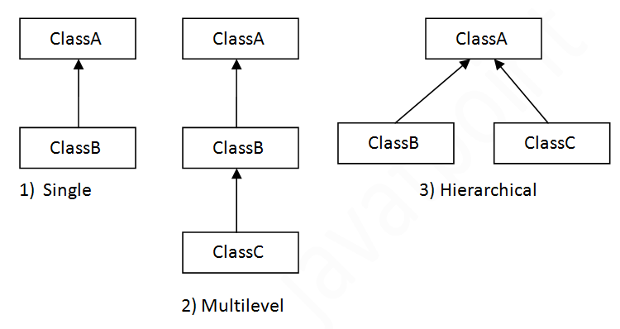
Types of inheritance in java

Slide 9
Why multiple inheritance is not supported in java?
To reduce the complexity and simplify the language, multiple inheritance is not supported in java.
Consider a scenario where A, B and C are three classes. The C class inherits A and B classes. If A and B classes have same method and you call it from child class object, there will be ambiguity to call method of A or B class.
Since compile time errors are better than runtime errors.

Slide 10
class A{
void msg(){System.out.println("Hello");}
}
class B{
void msg(){System.out.println("Welcome");}
}
class C extends A,B{//suppose if it were
Public Static void main(String args[]){
C obj=new C();
obj.msg();//Now which msg() method would be invoked?
}
}
Compile Time Error

Slide 11
Java Modifier Types
Modifiers are keywords that you add to those definitions to change their meanings. The Java language has a wide variety of modifiers, including the following:
Java Access Modifiers
Non Access Modifiers

Slide 12
Access Control Modifiers:
Java provides a number of access modifiers to set access levels for classes, variables, methods and constructors.
The four access levels are:
Visible to the package. the default. No modifiers are needed.
Visible to the class only (private).
Visible to the world (public).
Visible to the package and all subclasses (protected).

Slide 13
Private access modifier
The private access modifier is accessible only within class.
class A{
private int data=40;
private void msg(){System.out.println("Hello java");}
}
public class Simple{
public static void main(String args[]){
A obj=new A();
System.out.println(obj.data);//Compile Time Error
obj.msg();//Compile Time Error
}
}

Slide 14
If you make any class constructor private, you cannot create the instance of that class from outside the class.
Note: A class cannot be private or protected except nested class.

Slide 15
default access modifier
If you don't use any modifier, it is treated as default by default. The default modifier is accessible only within package.
package pack;
class A{
void msg(){System.out.println("Hello");}
}
//save by B.java
package mypack;
import pack.*;
class B{
public static void main(String args[]){
A obj = new A();//Compile Time Error
obj.msg();//Compile Time Error
}

Slide 16
protected access modifier
The protected access modifier is accessible within package and outside the package but through inheritance only.
The protected access modifier can be applied on the data member, method and constructor. It can't be applied on the class.

Slide 17
//save by A.java
package pack;
public class A{
protected void msg(){System.out.println("Hello");}
}
//save by B.java
package mypack;
import pack.*;
class B extends A{
public static void main(String args[]){
B obj = new B();
obj.msg();
}
} Output:Hello

Slide 18
public access modifier
The public access modifier is accessible everywhere. It has the widest scope among all other modifiers.

Slide 19


Slide 20
Non Access Modifiers:
Java provides a number of non-access modifiers to achieve many other functionality.
The static modifier for creating class methods and variables
The final modifier for finalizing the implementations of classes, methods, and variables.
The abstract modifier for creating abstract classes and methods.

